Slide 1

POS tagging

Slide 2
Main Task
Download the corpora and split it in training and test sets, structuring a dataframe.
Embed the words using GloVe embeddings
Create a baseline model, using a simple neural architecture
Experiment doing small modifications to the baseline model, choose hyperparameters using the validation set
Evaluate your two best model
Analyze the errors of your model

Slide 3
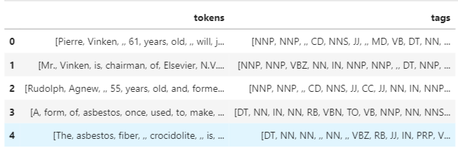
DataSet

Slide 4
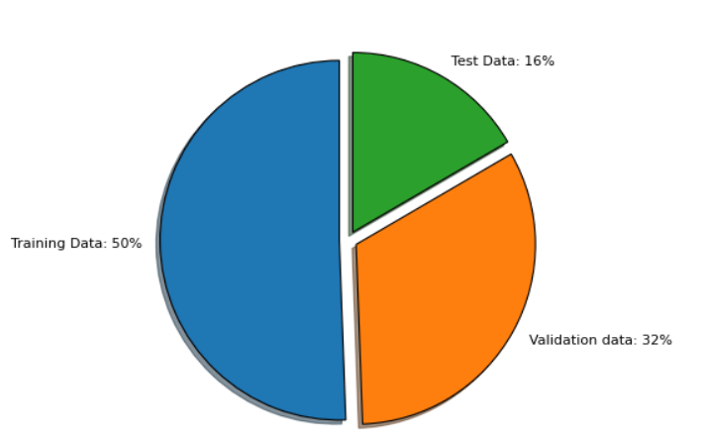
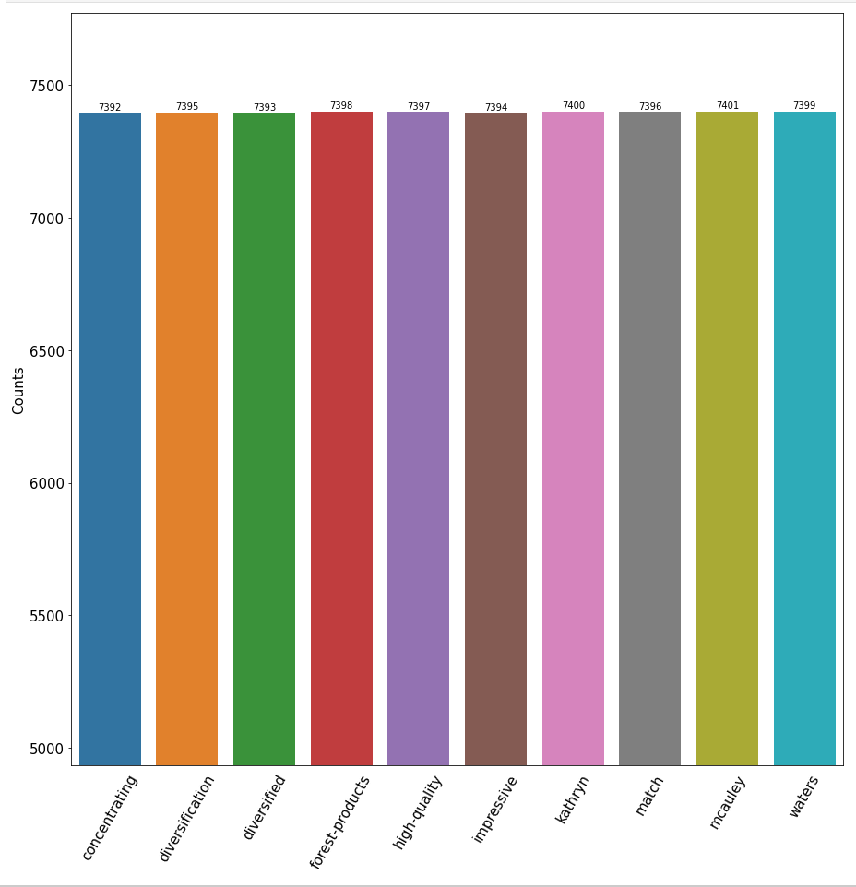
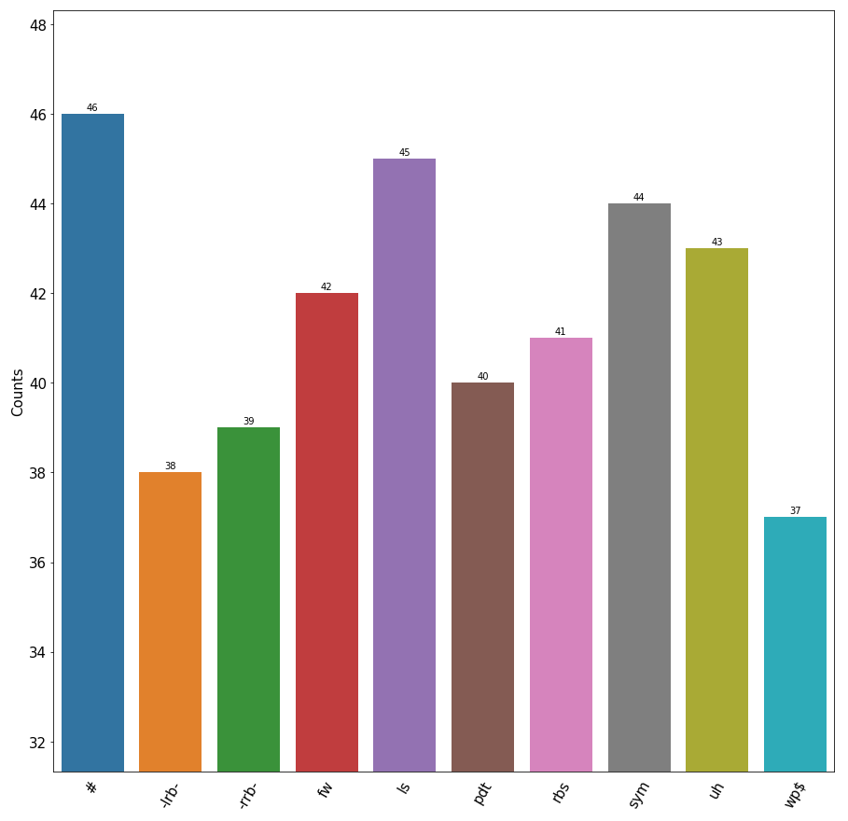
Data Exploration

Slide 5
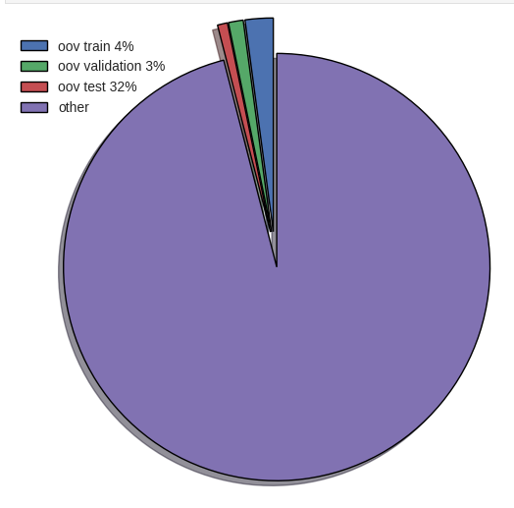
Handling Oov terms
Starting vocabulary V1 (in this assignment, GloVe vocabulary)
Compute embeddings for terms out of vocabulary V1 (OOV1) of the training split
Add embeddings to the vocabulary, so to obtain vocabulary V2=V1+OOV1
Compute embeddings for terms OOV2 of the validation split
Add embeddings to the vocabulary, so to obtain vocabulary V3=V1+OOV1+OOV2
Compute embeddings for terms OOV3 of the test split
Add embeddings to the vocabulary, so to obtain vocabulary V4=V1+OOV1+OOV2
Training of the model(s)
Validation of the model(s)
Testing of the final model

Slide 6
Neural Model
Recurrent neural networks (RNNs) process the input information sequentially.
1. BiLSTM_BiLSTM -> Two directional LSTM layer +FC softmax
2. BiLSTM -> Bidirectional LSTM + FC softmax
3. BiGRU -> Bidirectional GRU + FC softmax
4. GRU -> GRU +FC softmax

Slide 7
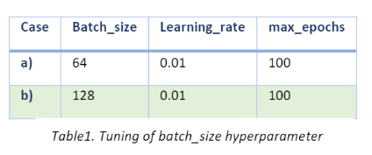
Hyperparameter

Slide 8
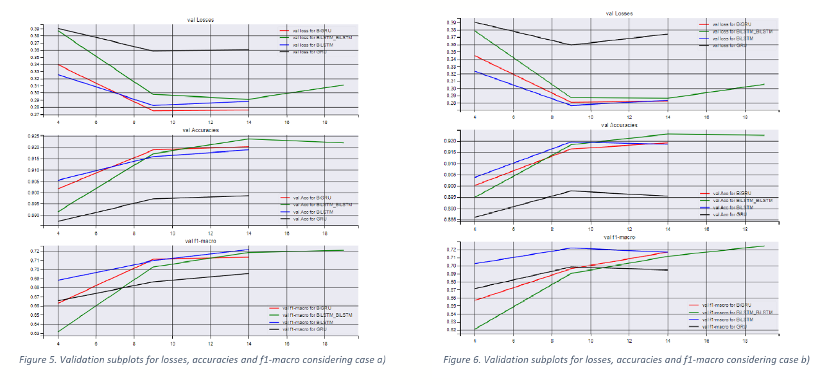
Result of Training and Validation set
BiGRU, BiLSTM
BiGRU, BiLSTM_BiLSTM

Slide 9
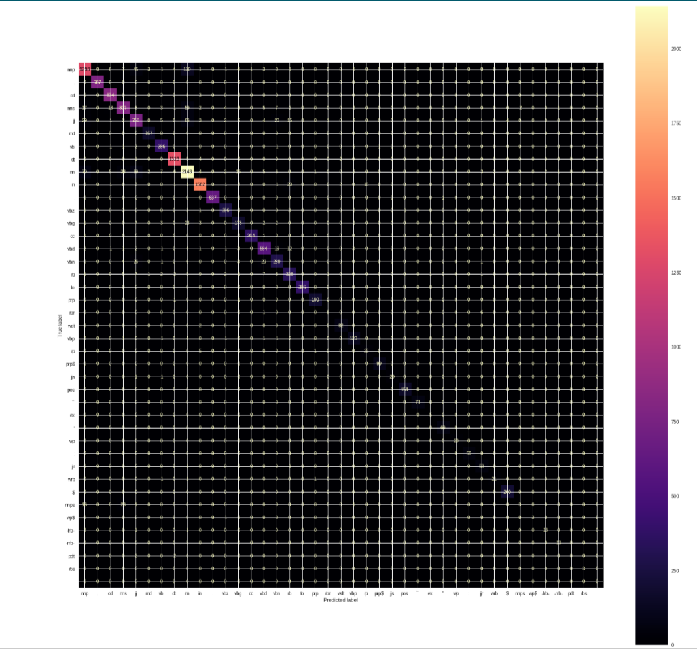
Results - BiGRU

Slide 10
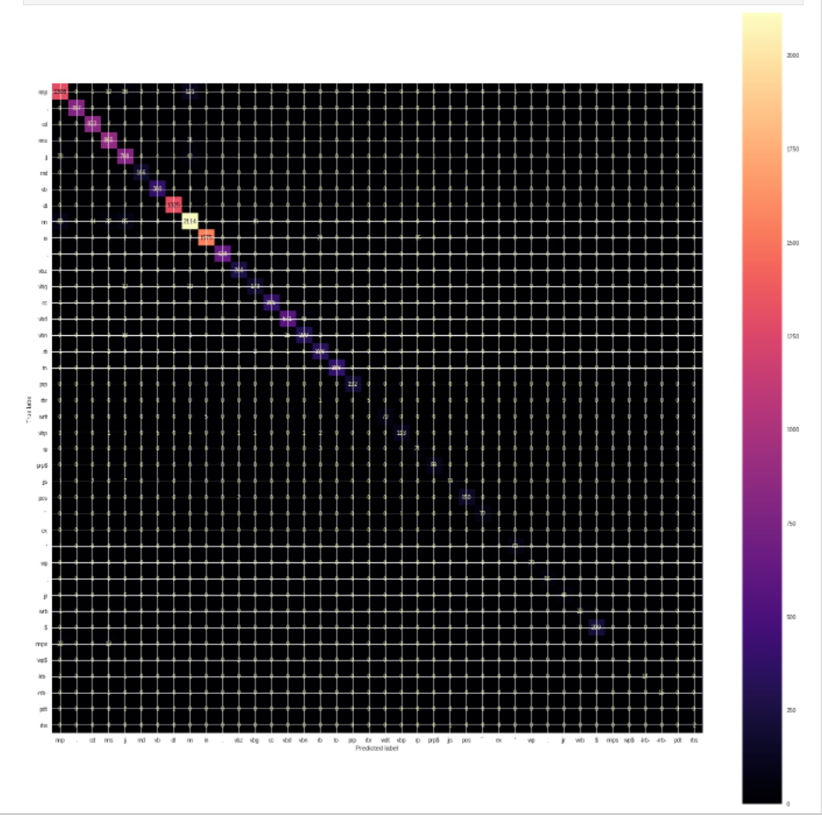
Results – BiLSTM_BiLSTM

Slide 11
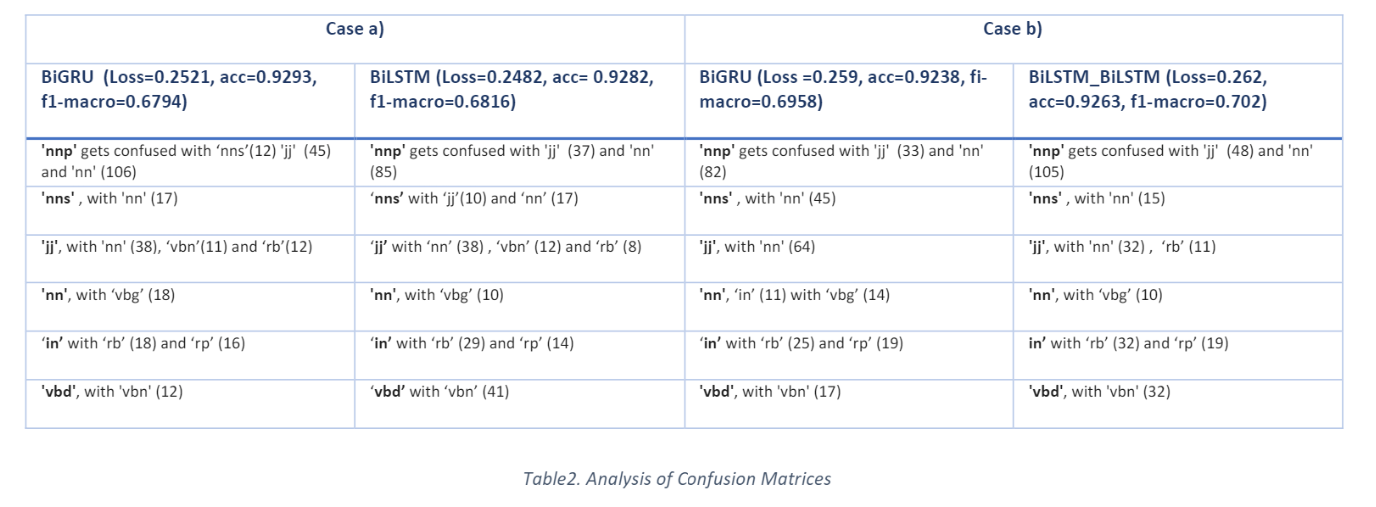
Error Analysis

Slide 12
Thank You

